Slide 1
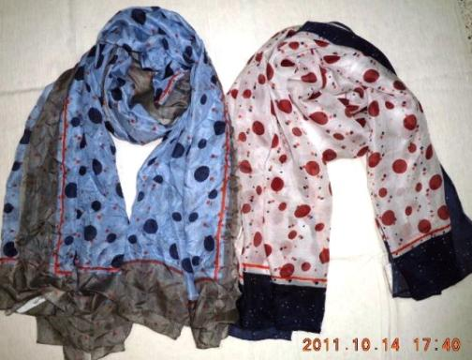
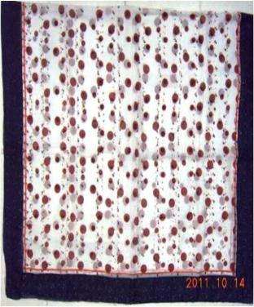
Style no - 6-82869
Quality - silk tabby
Size - 100x180cm
Color - 1.navy white
2. taupe sky

Slide 2
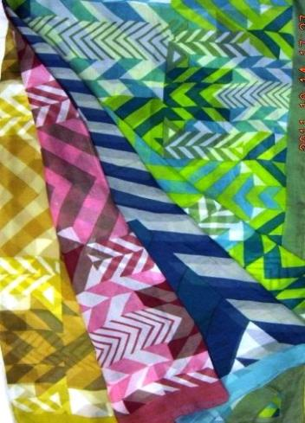
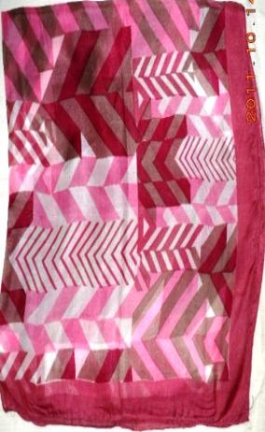
Style no - 7-17
Quality - 100%silk
Size - 100x100cm
Color - 1,2,3,4

Slide 3
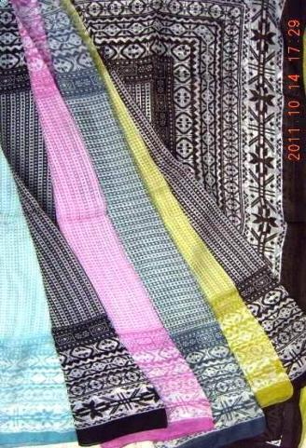
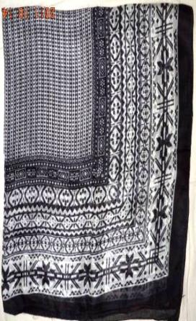
Style no -7s-1517
Quality -100%silk
Size -100x100cm
Color -1,2,3,4 ,5,6

Slide 4
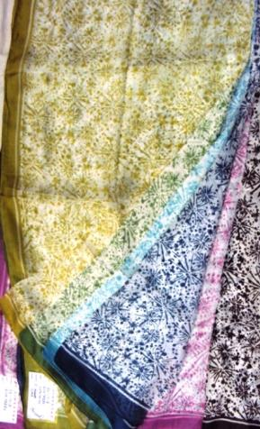
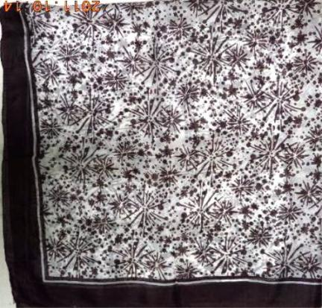
Style no -7s-1518
Quality -silk tabby
Size -100x100cm
Color -1,2,3,4 ,5,6,7

Slide 5
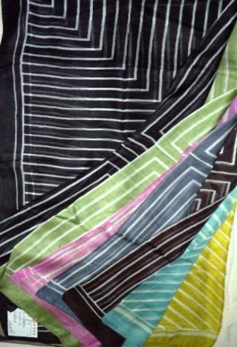
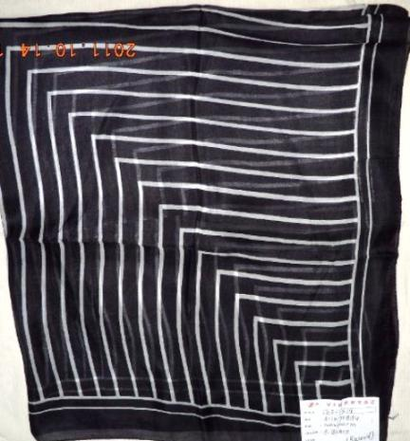
Style no -7s-1519
Quality -silk tabby
Size -100x100cm
Color -1,2,3,4 ,5

Slide 6
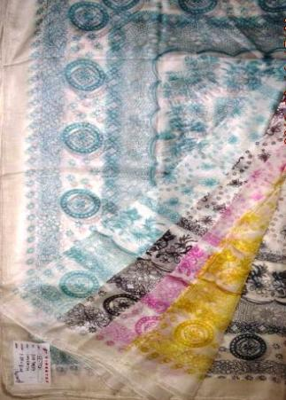
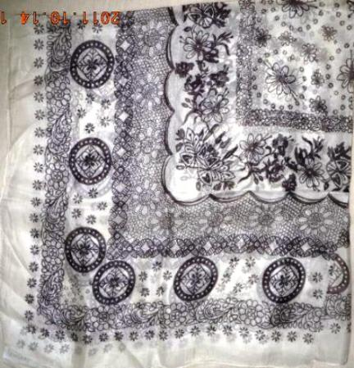
Style no -7s-1521
Quality -silk tabby
Size -100x100cm
Color -1,2,3,4 ,5

Slide 7
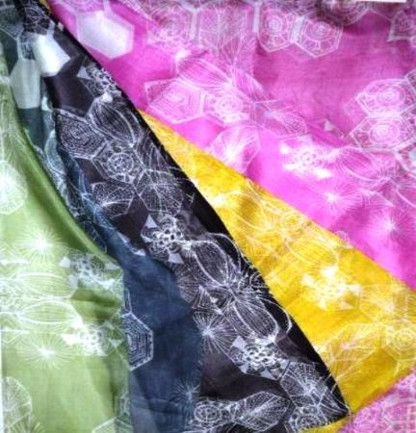
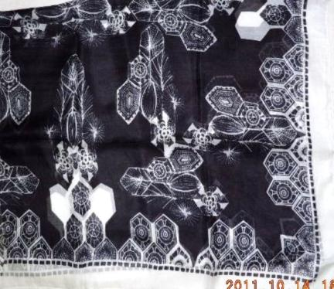
Style no -7s-1522
Quality -silk tabby
Size -100x100cm
Color -1,2,3,4 ,5,6

Slide 8
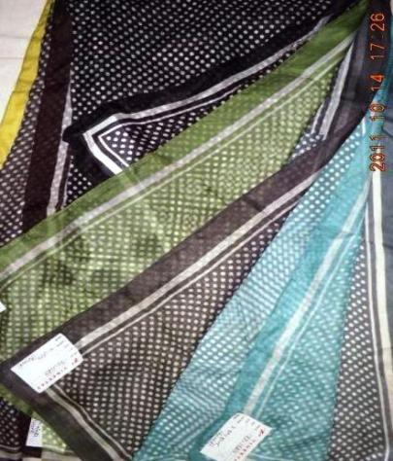
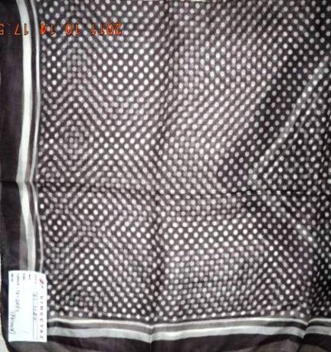
Style no -7s-1524
Quality -silk tabby
Size -100x100cm
Color -1,2,3,4 ,5,6,7

Slide 9
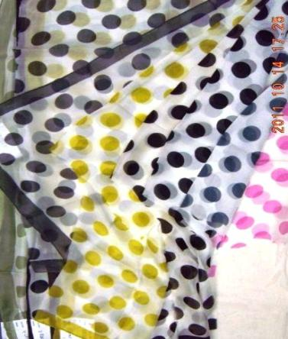
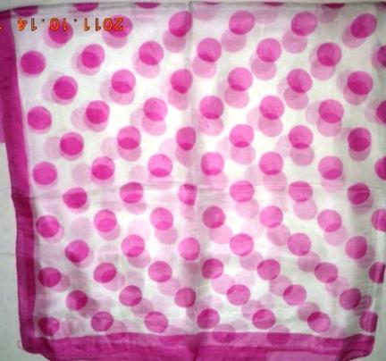
Style no -7s-1525
Quality -silk tabby
Size -100x100cm
Color -1,2,3,4 ,5,6,7

Slide 10
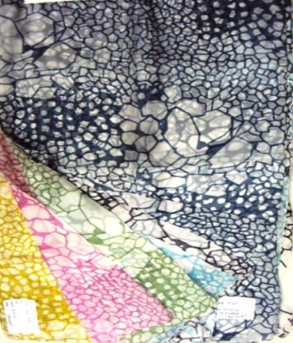
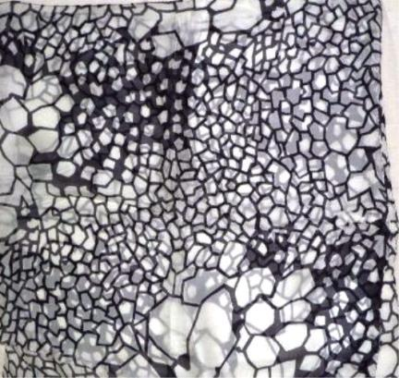
Style no -7s-1537
Quality -silk tabby
Size -100x100cm
Color -1,2,3,4 ,5,6,7

Slide 11
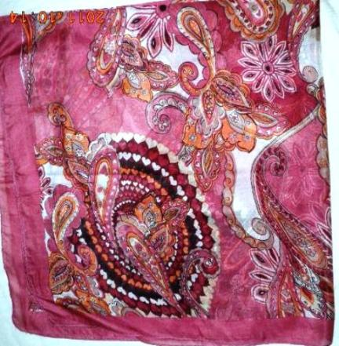
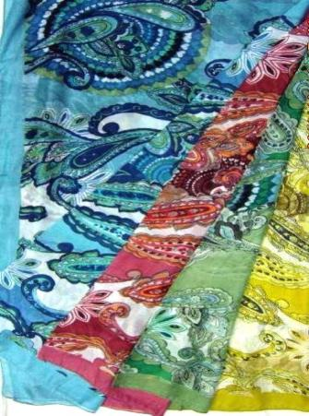
Style no -10-17
Quality -silk tabby
Size -100x100cm
Color -1,2,3,4

Slide 12
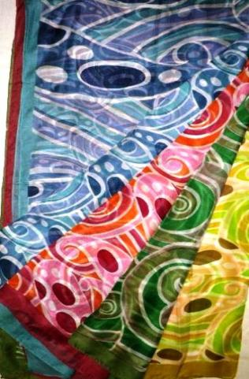
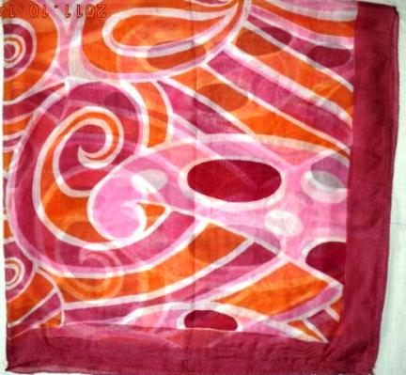
Style no -13-17
Quality -silk tabby
Size -100x100cm
Color -1,2,3,4

Slide 13
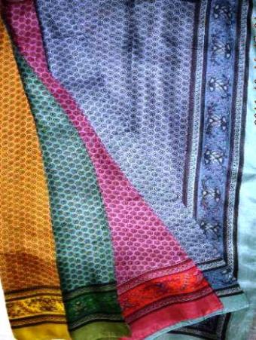
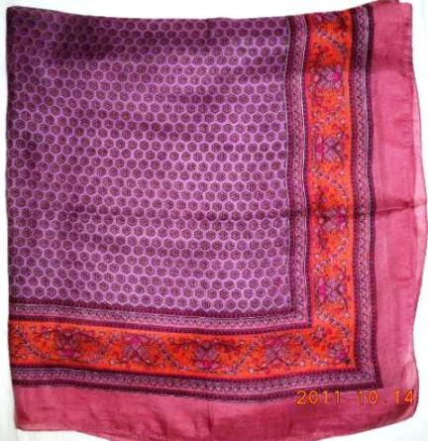
Style no -14-17
Quality -silk tabby
Size -100x100cm
Color -1,2,3,4

Slide 14
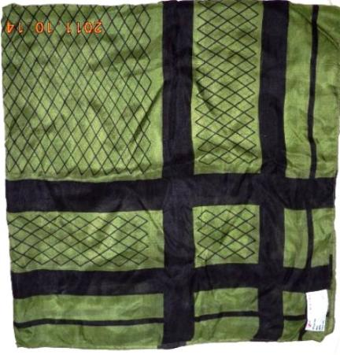
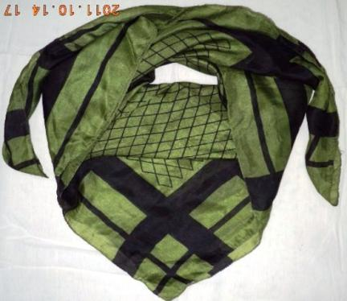
Style no -0507/222
Quality -silk tabby
Size -105x180cm
Color -green/black

Slide 15
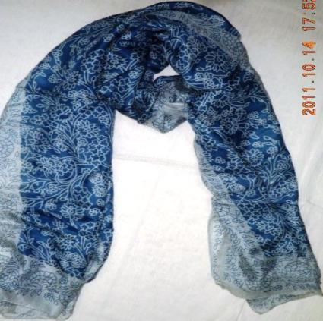
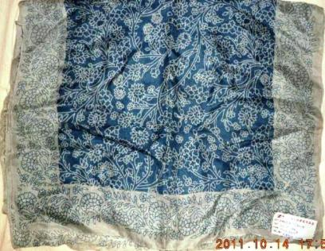
Style no -0707/1008
Quality -silk tabby
Size -50x160cm
Color -1.blue/grey

Slide 16
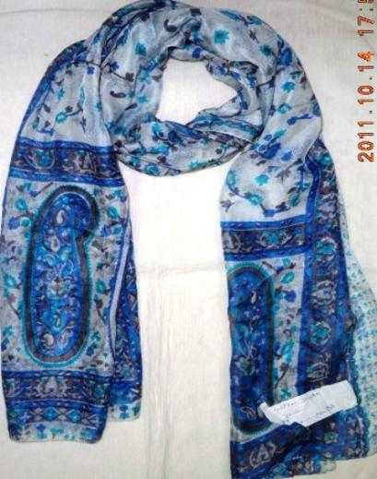
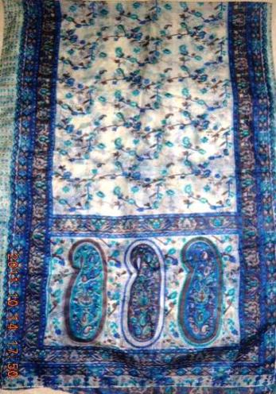
Style no -2030-sm
Quality -silk tabby
Size -50x180cm
Color -turq/blue

Slide 17
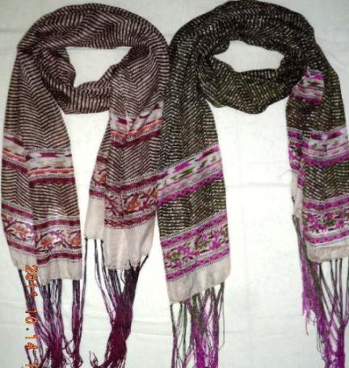
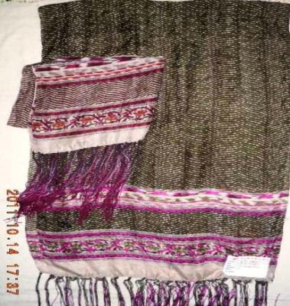
Style no -s-8-1223
Quality -silk tabby
Size -50x180cm+fr.
Color -1,4

Slide 18
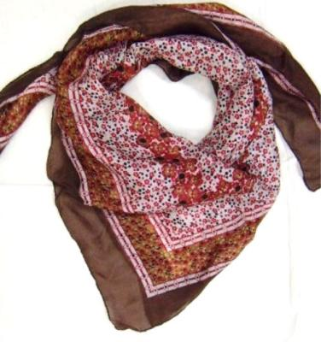
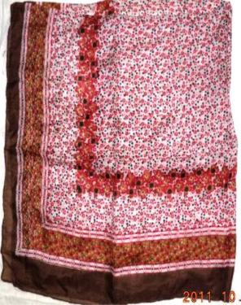
Style no -19-73716
Quality -silk tabby
Size -100x100cm
Color -1,2,3

Slide 19
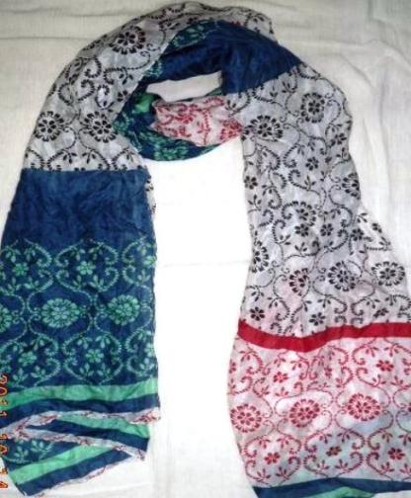
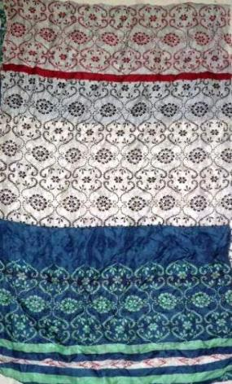
Style no - IN-94976
Quality - silk tabby
Size - 50x180cm
Color - 1,2,3

Slide 20
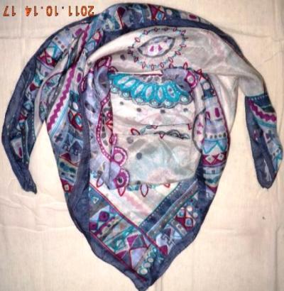
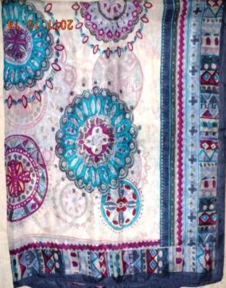
Style no -S-8-1069
Quality -silk tabby
Size -100X100CM
Color -1

Slide 21
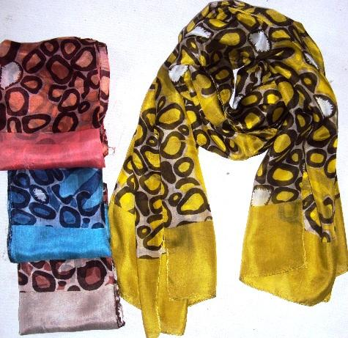
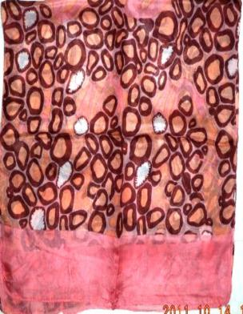
Style no - 7s-1565
Quality - silk tabby
Size - 50x180cm
Color - 1,2,,3,4

Slide 22
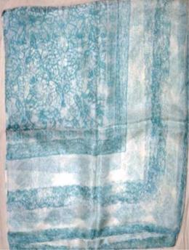
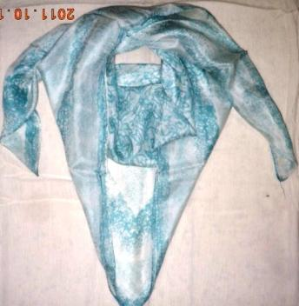
Style no - S-1575
Quality - silk tabby
Size - 100x100cm
Color - 1

Slide 23
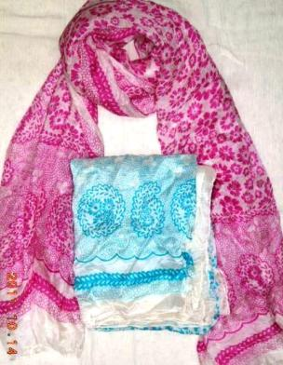
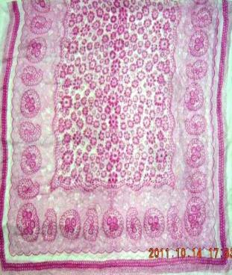
Style no - S-1573
Quality - silk tabby
Size - 105x180m
Color - 1.turq,2

Slide 24
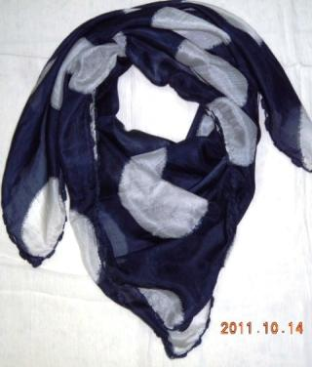
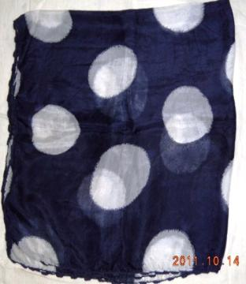
Style no - S-1574
Quality - silk tabby
Size - 100x100cm+lace
Color - 1.navy

Slide 25
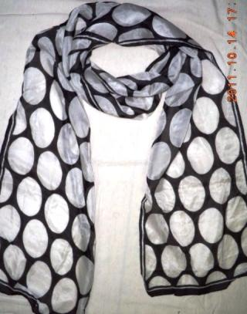
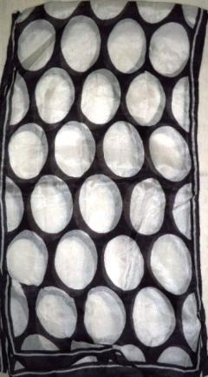
Style no - S-1576
Quality - silk tabby
Size - 25x200cm
Color - black

