Slide 1
NCSC-15
NCSC-16

Slide 2
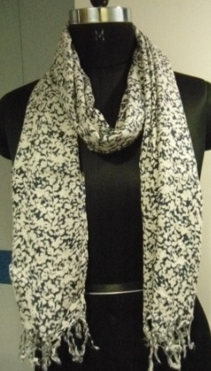
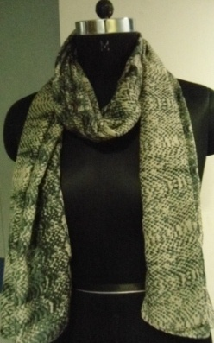
NCSC-2
NCSC-4

Slide 3
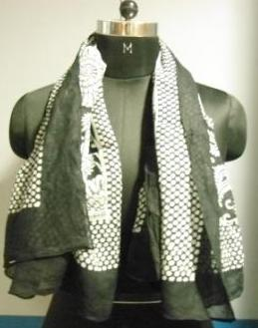
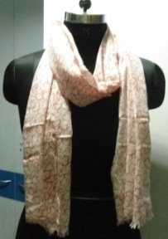
NCSC-6
NCSC-23

Slide 4
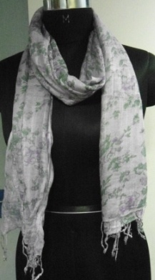
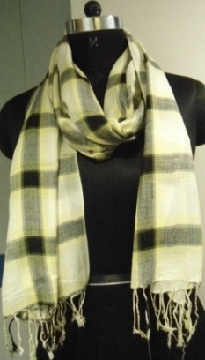
NCSC-17
NCSC-26

Slide 5
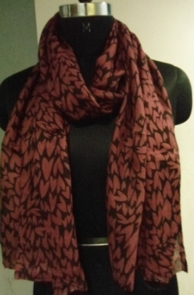
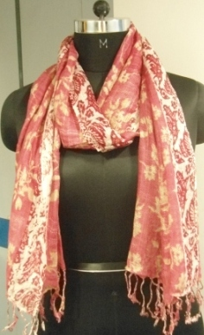
NCSC-5
NCSC-8

Slide 6
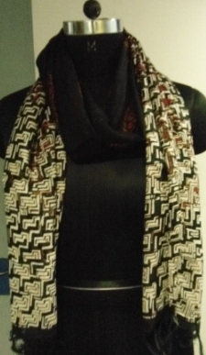
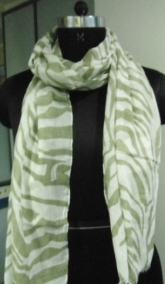
NCSC-7
NCSC-12

Slide 7
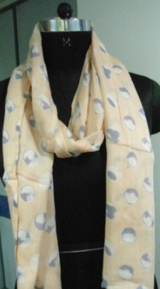
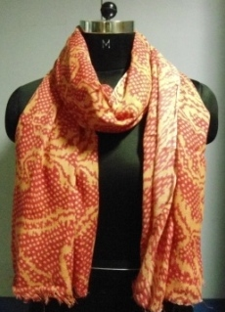
NCSC-10
NCSC-18

Slide 8
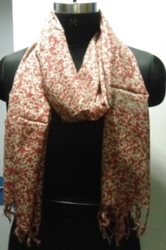
NCSC-25
NCSC-22

Slide 9
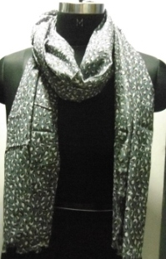
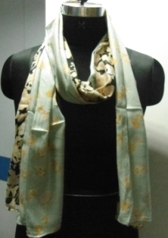
NCSC-1
NCSC-19

Slide 10
NCSC-21
NCSC-20

Slide 11
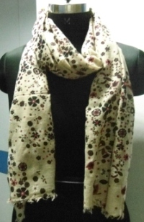
NCSC-3
NCSC-29

Slide 12
NCSC-28
NCSC-24

Slide 13
NCSC-9

